Slide 1
Reviving Tasik Maryam- Is there hope? (Group 10)
Name | Number Matric
Tuan Muhammad Afiq bin Tuan Azhari | 2019449
Nurhidayah binti Dasril | 2016322
Siti Nor Aisyah binti Kadir | 2017590
Nur Arisha Nadira binti Norisham | 2011256
Mohamad Yusoff bin Mohamad Azmi | 2014383

Slide 2
Table of Contents!
Introduction
Objective
Problem statement
Action plan
Proposed solution
The way to overcome the problem in general
Briefly discuss about the project
Main purpose and goals in this project
The main problem and issues in the project
Detailed about the solution

Slide 3
01
INTRODUCTION

Slide 4
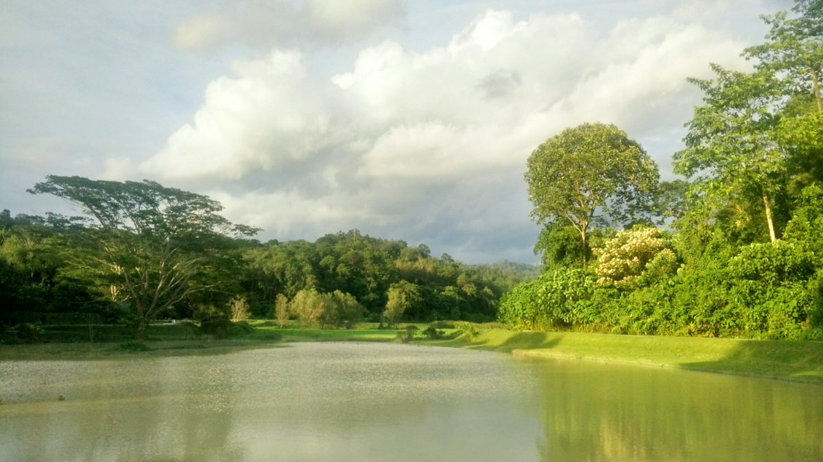
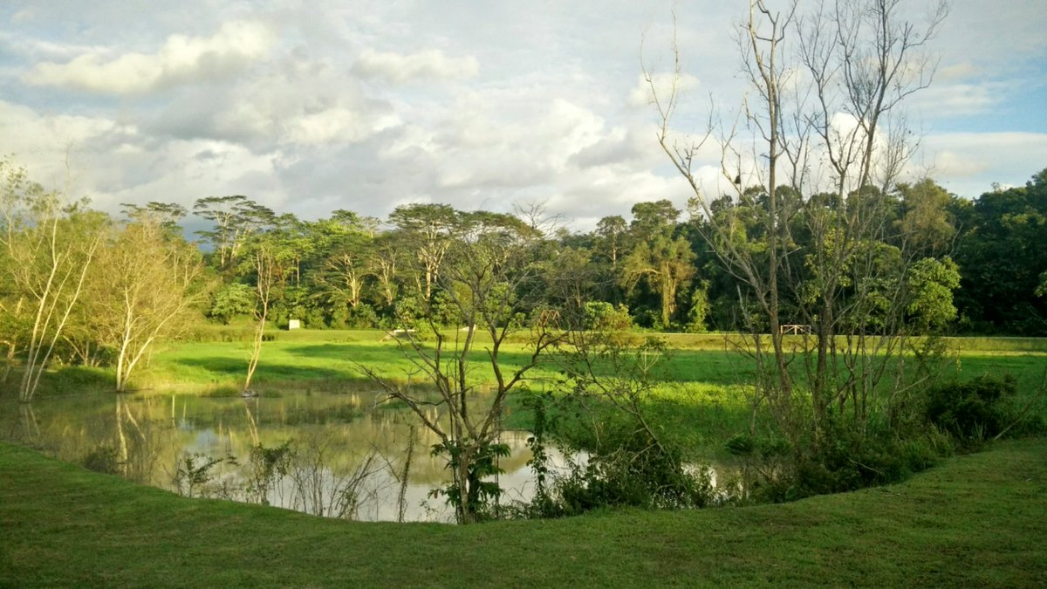
Introduction
What is the problem with Tasik Maryam currently?
Methods to tackle and solve those problems such as cleaning the environment of the lake and so on.
How the problem is related economically, environmentally and socially, and how it relates to SDGs 14 and 15.
To revive the lake back to its original state which was cleaner and sustainable.

Slide 5
02
PROBLEM STATEMENT

Slide 6
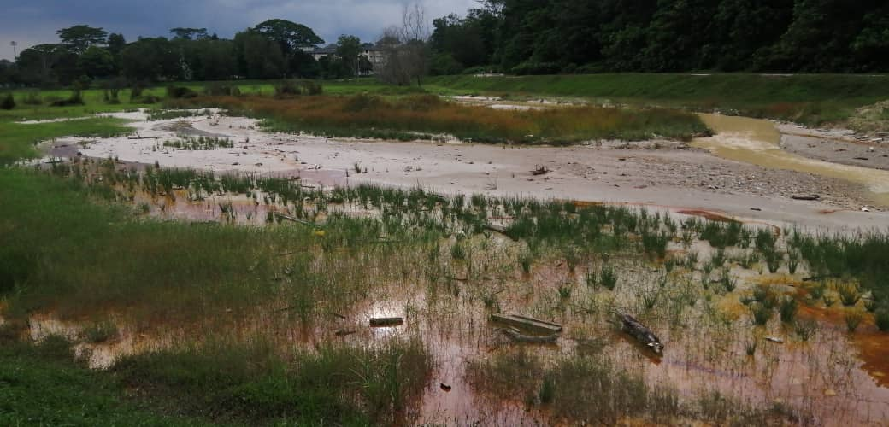
Problem statement
The lake is not being maintained and managed well (bad maintenance).
Lake is shallow and polluted due to logging works in the area.
Lights, benches, small huts and other forms of physical necessities are damaged and not being maintained.
Garbage everywhere not being removed and managed.
Relates to SDGs 14 and 15 because the damage caused on land and underwater.

Slide 7
03
PROPOSED SOLUTION

Slide 8
Proposed solution
Step 1
Step 2
Step 3
Step 4
Maintain the physical necessities that can be found at the Tasik such as lights, benches and small huts.
Fix and cover up any holes or gaps in the lake that may be caused by the logging works by asking the suitable IIUM body to fix it.
Find a suitable organization or body that can take care of and maintain the lake.
Place recycle bins around the Tasik so that the visitors have a place to throw their rubbish

Slide 9
04
PROJECT’S OBJECTIVES

Slide 10
Project’s objectives/ benefits
1st
4th
2nd
5th
3rd
To continue sustaining Tasik Maryam through the long term even after it has been revived.
To get it back to its original and cleaner state.
To make Tasik Maryam one of the key contributions to a greener and better IIUM campus.
To make it possible for the visitors to do the activities that was available before such as kayaking and cycling.
To reduce mosquitoes around the area.

Slide 11
05
ACTION PLAN

Slide 12
Action plan to execute the project
1st
2nd
4th
3rd
Inquire from the bodies of IIUM to integrate this proposal into the ‘Sejahtera Academic Framework’,to initiate the solutions for the Tasik Maryam. This includes the cleaning, fixing and sustaining of the Tasik.
Raise awareness of the problem by putting up banners around the Tasik about the problem and spread it through as many social media platforms as possible.
Inquire the IIUM bodies to place warning signs and guidelines around the lake to warn people to take care of the Tasik and how to sustain it. E.g a sign that states throw rubbish in the recycling bin and how it saves the environment.
Make the sustaining of Tasik Maryam one of the permanent objectives of the ‘Sejahtera Academic Framework’.

Slide 13
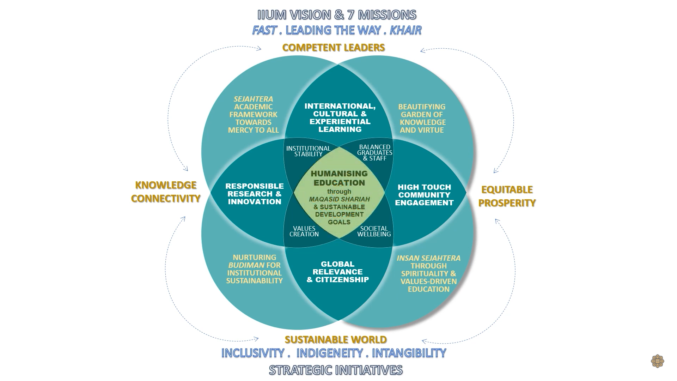
Link: https://www.iium.edu.my/page/sejahtera-academic-framework-for-the-future
‘Sejahtera Academic Framework’

